Slide 1
Machine Learning and Neural Networks
And YOU

Slide 2
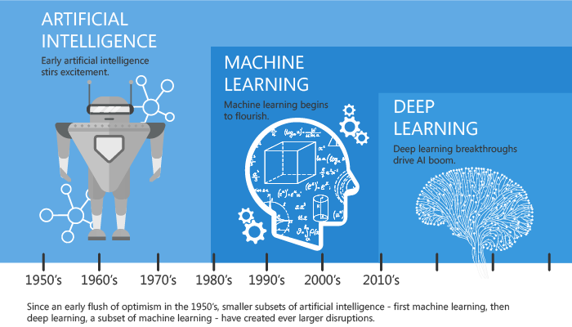
What are Artificial Intelligence, Machine Learning

Slide 3
What is a Neural Network?

Slide 4
Forward Propagation & Backpropagation

Slide 5
Gradient Descent

Slide 6



Your (Possibly) First Neural Network

Slide 7
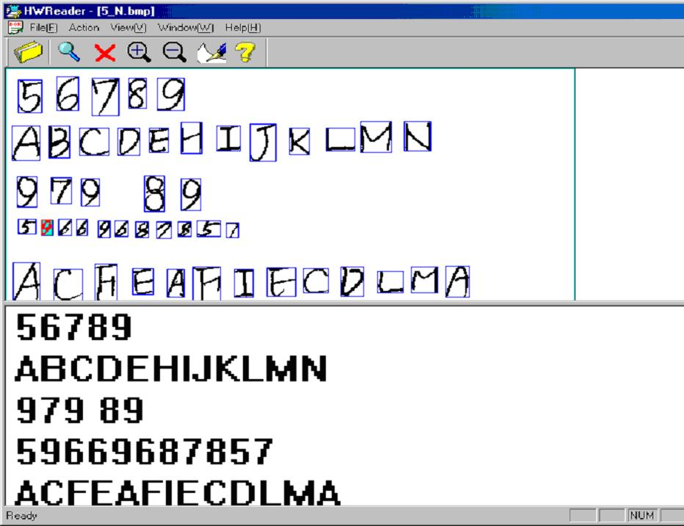

Optical Character Recognition

Slide 8
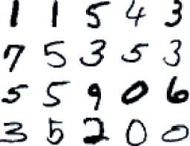
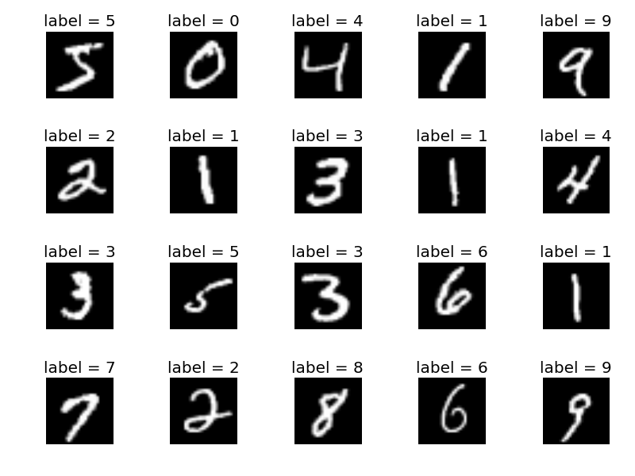
MNIST Dataset

Slide 9
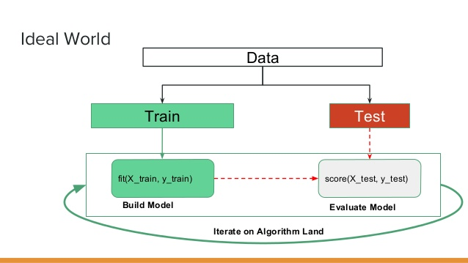
Separating a Dataset into Training and Testing

Slide 10
Reshaping
Each pixel becomes an input node for the network

Slide 11
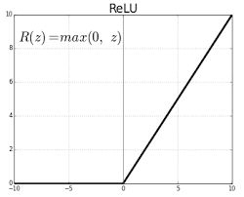
Activation Functions
Used to decide whether or not a node is activated or not.
Takes in the sum of the weighted inputs from the previous layer

Slide 12
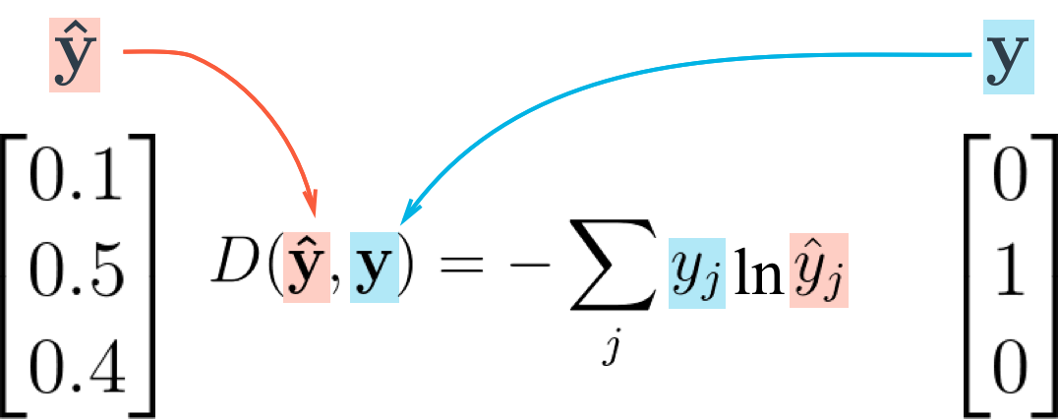
Calculating Loss
Categorical Cross Entropy
Used to calculate how incorrect our model is.

